Slide 1

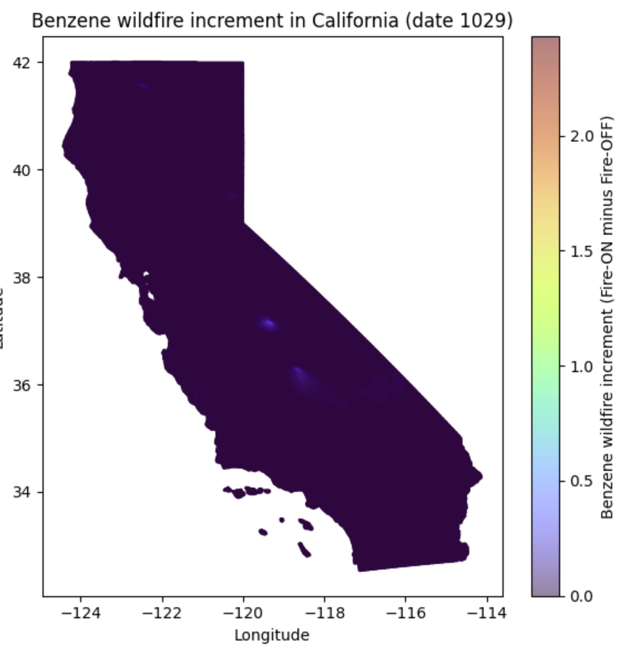
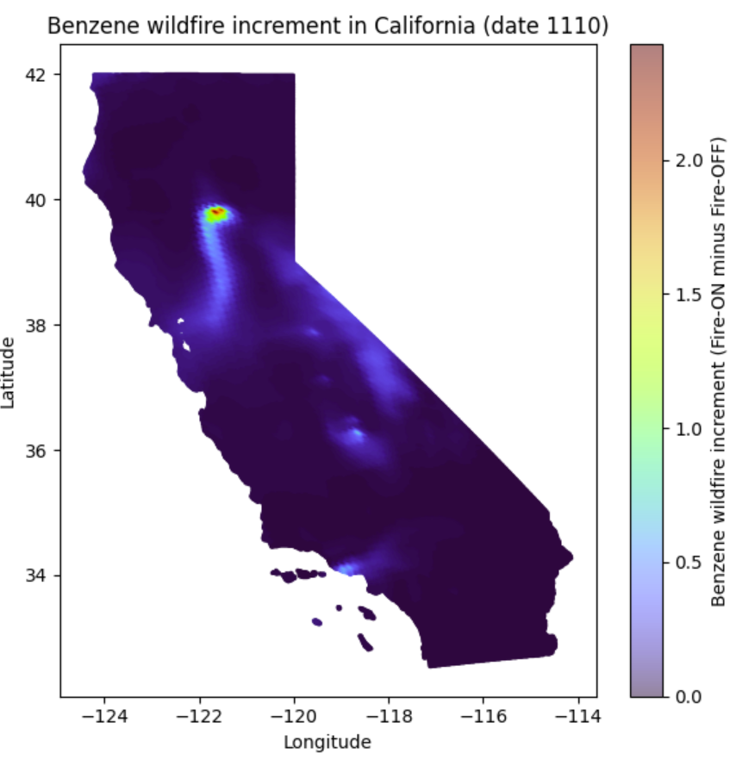
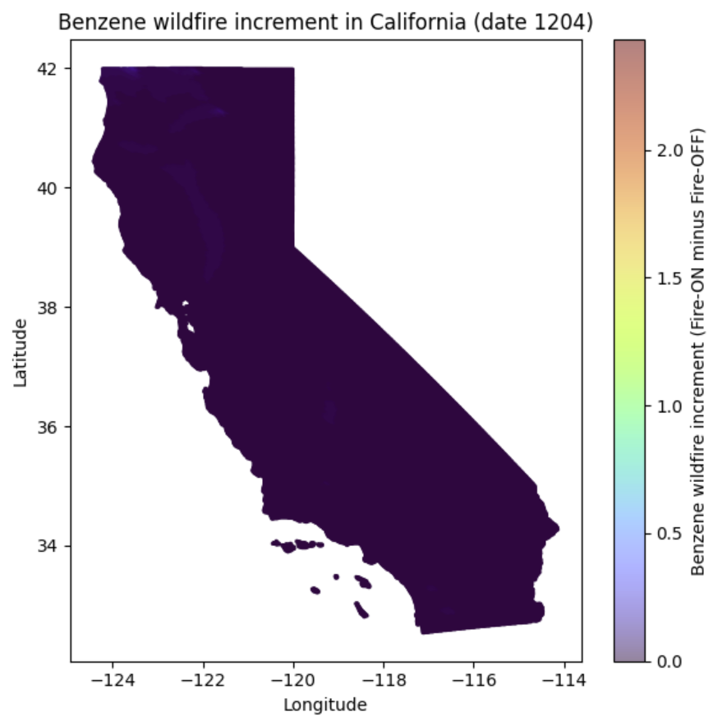

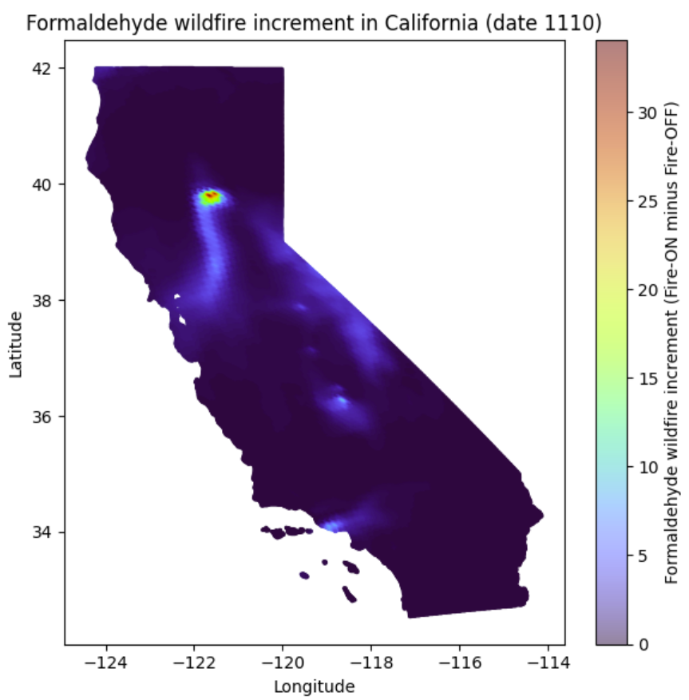
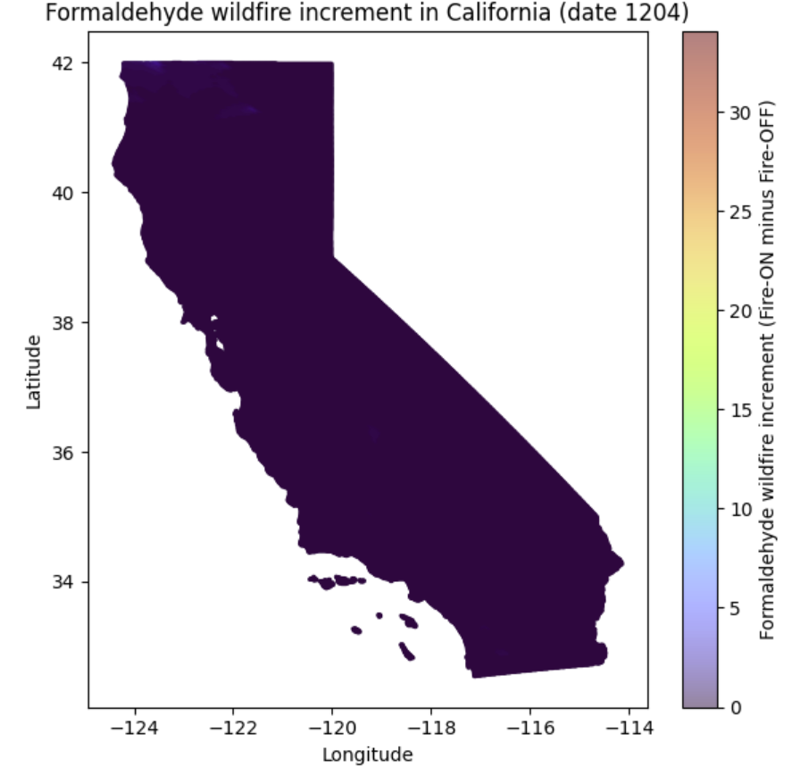
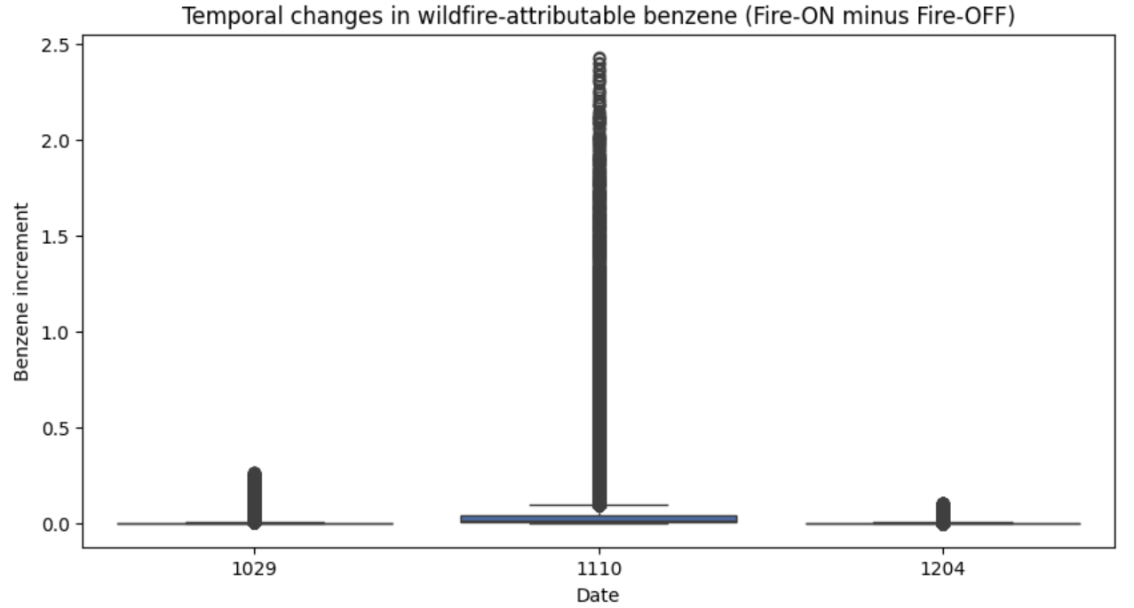
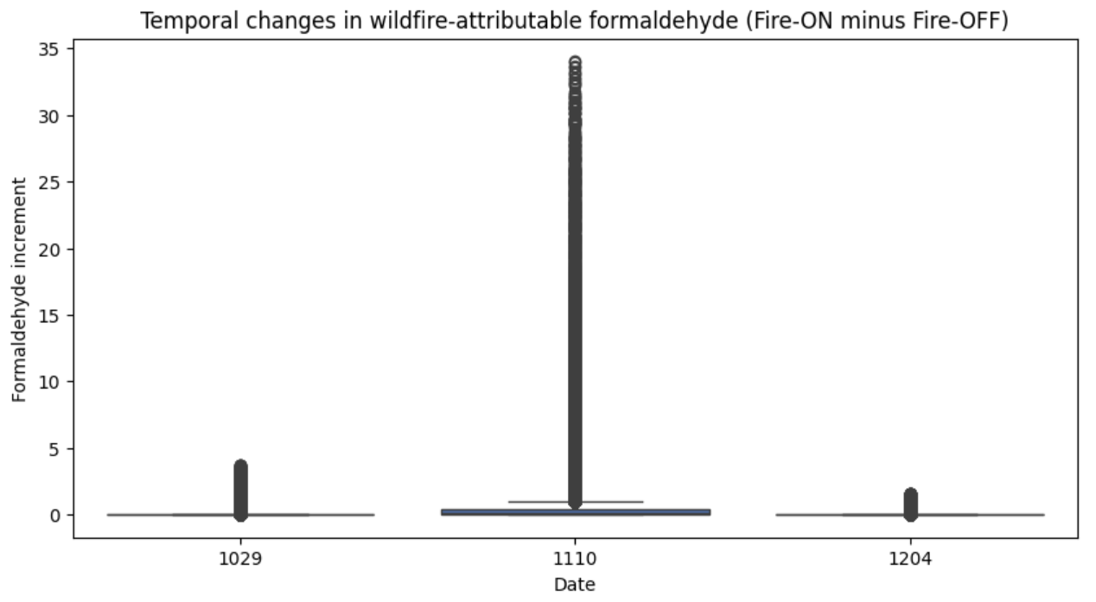
Wildfire Influence on Benzene and Formaldehyde Levels Across California
Binyu Yang
Rollins School of Public Health, Emory University
Abstract/Intro/Motivation
Results
Conclusions/Future Directions
Wildfire smoke is a major episodic contributor to hazardous air pollution in the western United States. During large wildfire events, combustion emissions substantially elevate levels of hazardous air pollutants, including benzene and formaldehyde—two toxic air contaminants with known health risks. Understanding how much wildfire emissions increase these pollutants, how these impacts vary across space, and how they evolve across the fire timeline is essential for exposure assessment and public health protection.
Previous research has shown that wildfire-related PM₂.₅ increases dramatically during major fire events, but much less work has quantified toxic VOCs such as benzene and formaldehyde using model-based simulations. CMAQ (Community Multiscale Air Quality) modeling provides a unique opportunity to isolate wildfire-attributable concentrations by comparing simulations with and without wildfire emissions.
This project focuses on three representative days during the 2018 wildfire season (pre-fire, peak fire, post-fire) to determine (1) whether wildfire emissions significantly elevate benzene and formaldehyde, (2) where these increases are most severe, and (3) how the magnitude of wildfire-attributable pollution evolves over time.
What is the central research problem or question you have been helping to explore?
What work has been done previously in this area?
This section can be a review of the literature that has been most important in your research area
Aim 1: Fire-ON vs Fire-OFF pollutant differences
Paired comparisons showed strong and statistically significant increases in both pollutants on all study days (paired t-tests, p < 0.0001 for all dates and pollutants). Largest increases occurred on 11/10, the known wildfire peak.
Mean wildfire-attributable increments:
Benzene:
10/29: 0.0023
11/10: 0.0441
12/04: 0.0040
Formaldehyde:
10/29: 0.0205
11/10: 0.5090
12/04: 0.0227
Both pollutants show a dramatic spike on 11/10, confirming the dominance of wildfire emissions.
Aim 2: Spatial patterns of wildfire-attributable pollution
Spatial maps revealed distinct wildfire-related hotspots:
11/10 showed strong, localized plumes, especially in northern California near the Camp Fire region.
10/29 and 12/04 displayed minimal or diffuse increments, consistent with background conditions.
Spatial patterns were similar across pollutants, though formaldehyde increments were substantially larger, reflecting differences in chemical production and plume behavior.
These patterns illustrate how wildfire smoke differentially affects downwind areas.
Aim 3: Temporal changes across the three study days
Temporal summaries and boxplots showed a clear wildfire-related time pattern:
Pollutant increments were low on 10/29 → extremely high on 11/10 → returned to near-baseline on 12/04.
95th-percentile increments:
Formaldehyde p95 • 10/29: 0.065 • 11/10: 2.484 • 12/04: 0.090
Benzene p95 • 10/29: 0.0074 • 11/10: 0.191 • 12/04: 0.0090
Together, these results indicate a clear temporal arc (low → extreme → low), matching the documented wildfire timeline in California.
Wildfire emissions substantially increased benzene and formaldehyde, especially during peak fire activity on November 10.
Spatial hotspot analysis identified concentrated plumes consistent with known wildfire burn areas.
Temporal patterns show a sharp rise and fall in pollutant increments aligned with wildfire intensity.
Overall, CMAQ Fire-ON minus Fire-OFF differences provide a clear and interpretable measure of wildfire-attributable pollution.
Future Directions
Extend analyses to additional dates to capture full fire-season dynamics.
Apply spatial interpolation or smoothing to better characterize plume morphology.
Integrate health outcome or exposure models to assess potential population impacts.
Evaluate additional wildfire-related pollutants (e.g., PM₂.₅, NO₂).
Methods/Approach
We used CMAQ model outputs generated under two scenarios—Fire-ON (with wildfire emissions) and Fire-OFF (without wildfire emissions)—for three dates in 2018: October 29, November 10, and December 4. Data for both pollutants (benzene and formaldehyde) were paired by grid cell using a shared unique identifier, allowing one-to-one comparison of Fire-ON vs Fire-OFF values.
To quantify wildfire-attributable pollution, we computed cell-level differences (Fire-ON minus Fire-OFF) for each pollutant and each date. Statistical analyses were conducted entirely in Python using pandas, numpy, and scipy. Approaches included:
Paired comparisons to evaluate Fire-ON vs Fire-OFF differences within each date.
Spatial analysis using lat/lon coordinates to visualize pollutant increments across California.
Temporal analysis comparing distributions of increments across the three dates (pre-fire, peak fire, post-fire).
Visualizations including scatter heatmaps and boxplots constructed with matplotlib and seaborn.
These methods allow us to isolate wildfire-driven increases, identify geographic hotspots during the fire peak, and trace temporal shifts in pollutant levels consistent with the fire progression.
Acknowledgements
Contact: binyu.yang@emory.edu
No funding information applied

